Slide 1
HOME AUTOMATION USING IOT
TEAM MEMBERS
13BCS002(ABUBACKER ASHIQ.S)
13BCS003(AJITH PRUTHVI.S)
13BCS018(ASHWIN VELMURUGAN)

Slide 2
INTRODUCTION
The internet of things (IoT) is the internetworking of physical devices, vehicles, buildings and other items—embedded with Electronics, Software, Sensors, Actuators, and network connectivity that enable these objects to collect and exchange data.
"Things“, in the IoT sense, can refer to a wide variety of devices such as heart monitoring implants, biochip transponders on farm animals, electric clams in coastal Waters, Automobiles with built-in sensors, DNA analysis devices for environmental/food/pathogen monitoring or field operation devices that assist firefighters in search and rescue operations.
So let us have a look on how IoT can be integrated or used for home automation

Slide 3
Home Automation
Home automation is the process of controlling home appliances automatically using various control system techniques. The electrical and electronic appliances in the home such as fan, lights, outdoor lights, fire alarm, kitchen timer, etc., can be controlled using various control techniques.

Slide 4
Wireless Home Automation using IOT (Internet Of Things)
The process of controlling or operating various equipment, machinery, industrial processes, and other applications using various control systems and also with less or no human intervention is termed as automation. There are various types of automation based on the application they can be categorized as home automation, industrial automation, autonomous automation, building automation, etc.,.Let us discuss about wireless home automation using IOT (Internet of Things).

Slide 5
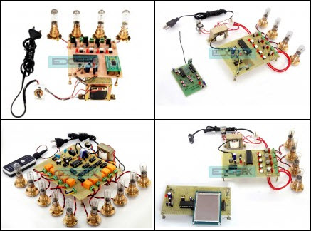
There are various techniques to control home appliances such as IOT based home automation over the cloud, home automation under WiFi through android apps from any Smartphone, Arduino based home automation, home automation by android application based remote control, home automation using digital control, RF based home automation system and touch screen based home automation.
Wireless home automation using IOT is an innovative application of internet of things developed to control home appliances remotely over the cloud. The home automation system project can be developed by following simple steps shown below.

Slide 6
LITERATURE SURVEY
“Home Automation Using Internet of Things”
By:
Vinay sagar-Student IV SEM, M.Tech, Digital Communication. Engg.
Kusuma- MSRIT, Bangalore, India 2 Assistant Professor, Department of telecommunication, MSRIT, Bangalore, India.
Home Automation system(HAS) using Intel Galileo that employs the integration of cloud networking, wireless communication, to provide the user with remote control of various lights, fans, and appliances within their home and storing the data in the cloud. The system will automatically change on the basis of sensors’ data. This system is designed to be low cost and expandable allowing a variety of devices to be controlled.

Slide 7
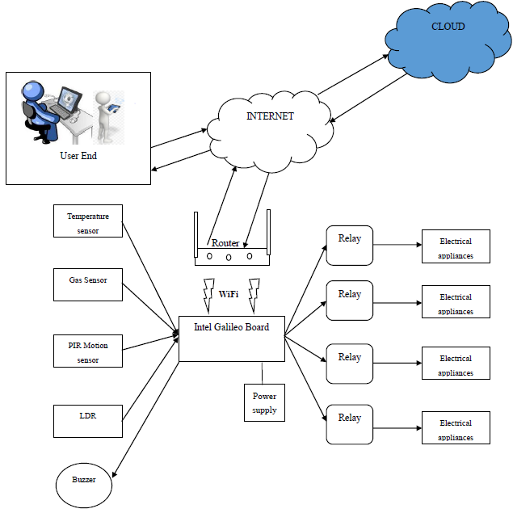
BLOCK DIAGRAM

Slide 8
“WIRELESS HOME AUTOMATION TECHNOLOGY (WHAT)
USING INTERNET OF THINGS (IOT)”.
BY:
1Kaushik Ghosh
2Rushikesh Kalbhor
3Disha Tejpal
4Sayali Haral
Department of Computer Engineering, Savitribai Phule Pune University
A novel architecture for low cost and flexible home control and monitoring system using Android based Smart phone is proposed. Any android based mobile can be used to control different devices using web server. Such project can be very useful for old and physically disabled people. The project has vast scope for development. Many different features can be added later . Voice controlling enables users a sense of comfort as no direct operation with the home automation system is required. The proposed system reduces the wiring by using wireless networks.

Slide 9
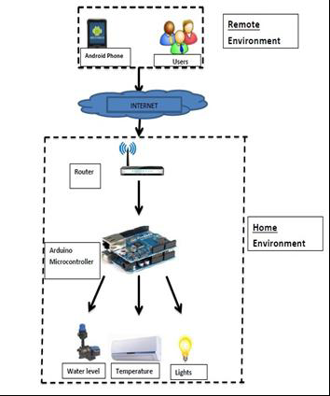
BLOCK DIAGRAM:

Slide 10
OUR PROPOSED SYSTEM
Even though there are a lot of ways to carry out home automation, we’ve planned to develop a home automation system using “INTEL GALILEO”. So let’s have a look on how to do this.
What are the materials required to do this project?
Hardware :
Intel Galileo Board
Five 5V SPDT relays like : 5V relay.
Prototype board or breadboard.
Connecting wires.
Software :
Arduino IDE : Arduino .
Eclipse for android programming (optional, not required).
So how does it work?
The Android Home Automation project comes with a free application called “SmartHome” . This application controls the various appliances connected to your Intel Galileo and relays. When the toggle buttons on the application are pressed, corresponding signals are sent from your android phone to the WiFi module which has come inbuilt with the Intel Galileo Board. The Intel Galileo finds out which signal was sent and compares it to the predefined signals assigned for each appliance. When it identifies that signal, then the Intel Galileo activates the relay hooked up to its digital pin by passing 5V through it. Thus the relay is switched ON and the corresponding appliance connected to the relay is turned ON as well. To switch it OFF, Intel Galileo passes a 0V or logic low to its digital pin.

Slide 11
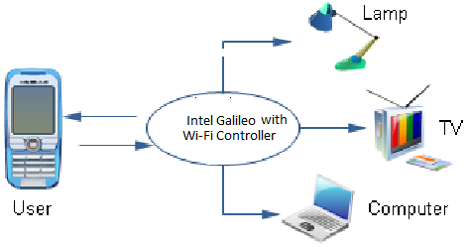
BLOCK DIAGRAM:

Slide 12
REFERENCES
Vinay sagar, Kusuma- Home Automation Using Internet of Things.
International Research Journal of Engineering and Technology (IRJET) Volume: 02 Issue: 03 | June-2015
Kaushik Ghosh, Rushikesh Kalbhor-WIRELESS HOME AUTOMATION TECHNOLOGY (WHAT) USING INTERNET OF THINGS (IOT).
International Journal of Technical Research and Applications www.ijtra.com Volume 3, Issue 6 (November-December, 2015)

